Slide 1
Optimizing OData Queries for Reporting and Integrations
Alexander Givant - Lipscomb University
Dylan Harvard - Anthology
July 17, 2023 – Nashville, TN

Slide 2


Who are we?
Alexander Givant
Director of Administrative Systems
Lipscomb University
Dylan Havard
Director of Integration Architecture
Anthology

Slide 3
Agenda
A Little about Lipscomb
What is OData?
Using OData
Lipscomb’s Integrations Problems Where did we come from, where did we go?
Takeaways
Notes:
We are going to get a little into the weeds about OData, but this is primarily a session on how to properly use OData and avoid some of the mistakes we made. This is not a comprehensive session on how to integration with the Anthology APIs

Slide 4
A Little About Lipscomb

Slide 5
Some History
Switched to Anthology Student in 2020
Previously a Banner school for the past 20 years
Systems hosted on-premises
Direct access to Oracle databases
Integrations written primarily using PL/SQL
Access by additional third-party reporting tools

Slide 6

Where we Started
Meal Plans
New, cloud-hosted system
No direct access to the database
Many integrations to re-write very quickly
Little familiarity with API integrations in general
Contractors brought in to help re-write integrations
Specifically unfamiliar with OData
Housing
ID Cards
Bookstore
Health Services
Admissions
Notes:
We will return to Lipscomb a bit later. For now, let’s move to OData

Slide 7
What is OData?

Slide 8
What is OData?
Dynamically-structured API
“Microsoft’s GraphQL”
Open standard, primarily used by Microsoft
Pseudo-SQL interface
“SQL for the web”
Allows performing many operations server-side
Selecting, Filtering, Sorting, Joining
Only get what you need!
Usually in a single query
Used in other Anthology products as well

Slide 9
Statically vs. Dynamically-Structured APIs
Static
Dynamic
Endpoints with a consistent return structure/model for each
More broad support in existing tools
Pre-optimized operations
Easier to use “correctly”
Limited flexibility
Defined model, but flexible return format
More options for server-side operations
Flexible and nestable filters
Risk of poor client and server performance

Slide 10
Using OData

Slide 11
OData and SQL
OData queries translate into SQL queries
Uses EntityFramework under the hood
OData query string parameters roughly map to SQL keywords
$select = select
$filter = where
$orderby = order by
$expand ~= join

Slide 12
Choose an Entity The OData $metadata
Every OData API has a $metadata endpoint
https://mystudentapi/ds/odata/$metadata
EDMX-ish XML file
Describes all entities, properties, and navigation properties
Entities ~= endpoints
Endpoint names are pluralized
Not all entities are standalone endpoints
Navigation properties = expandable properties
Same entities used in Student Views, Workflow, and other related tools

Slide 13
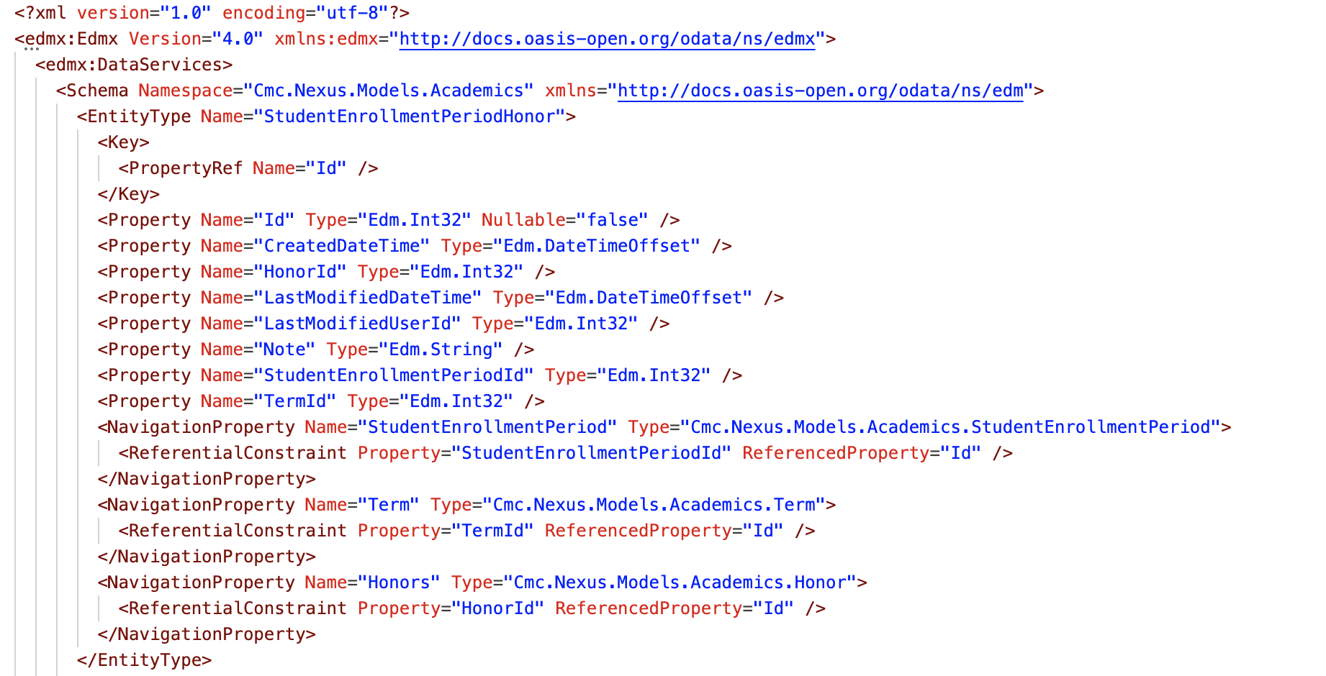
Example $metadata File

Slide 14
Building Queries

Slide 15
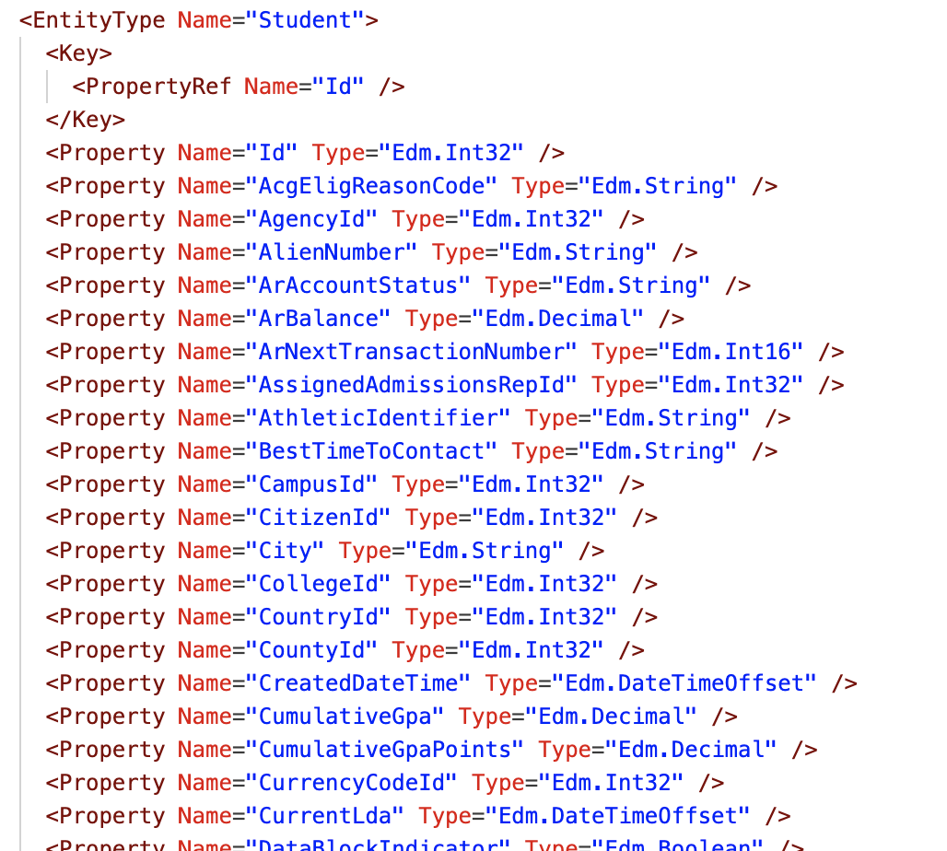
Including Specific Properties using $select
By default, all properties are included
This is a lot of data
111 properties in the Student entity
We can select only the specific properties we need for a query
Any property in the Student entity can be selected
As many properties can be selected as are needed

Slide 16
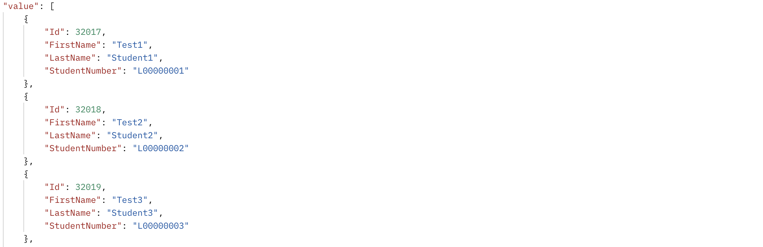
Including Specific Properties using $select
.../odata/Students?$select=Id, FirstName, LastName, StudentNumber

Slide 17
Sorting Results with $orderby
Sort data by any property, all server-side
Type-aware sorts
Specify sort order
Ascending or descending
Supports multi-level sorts
Specific sort order by property
Order by properties of related entities

Slide 18
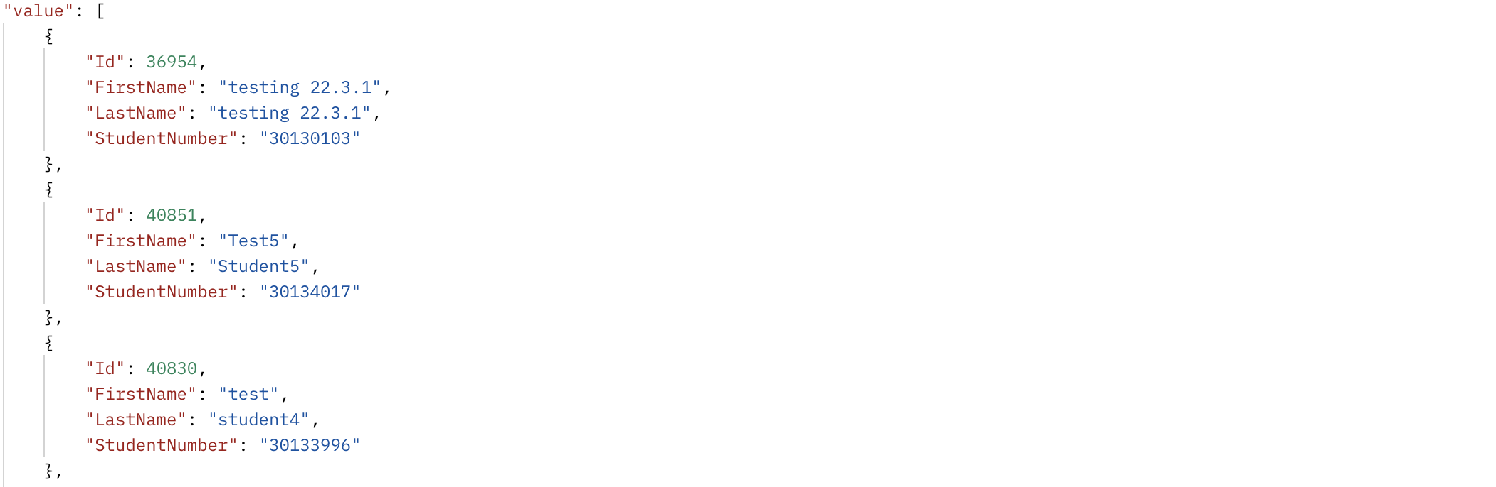
Sorting Results with $orderby
.../odata/Students ?$select=Id, FirstName, LastName, StudentNumber &$orderby=LastName desc

Slide 19
Filtering Results with $filter
Filter on any property of the selected entity – also server-side
Complex filters using and, or, and ()
Supports data-type-specific filters
Numeric and date comparisons
StartDate ge 2022-08-21
Supports filtering on properties of related entities
Includes functions for more powerful filters
Filter related lists using any() and all() functions
Common Comparison Operators
eq, ne – equals, not equals
gt, ge – greater than, greater than or equal
lt, le – less than, less than or equal
Common Functions
contains()
startswith()
any()
all()

Slide 20
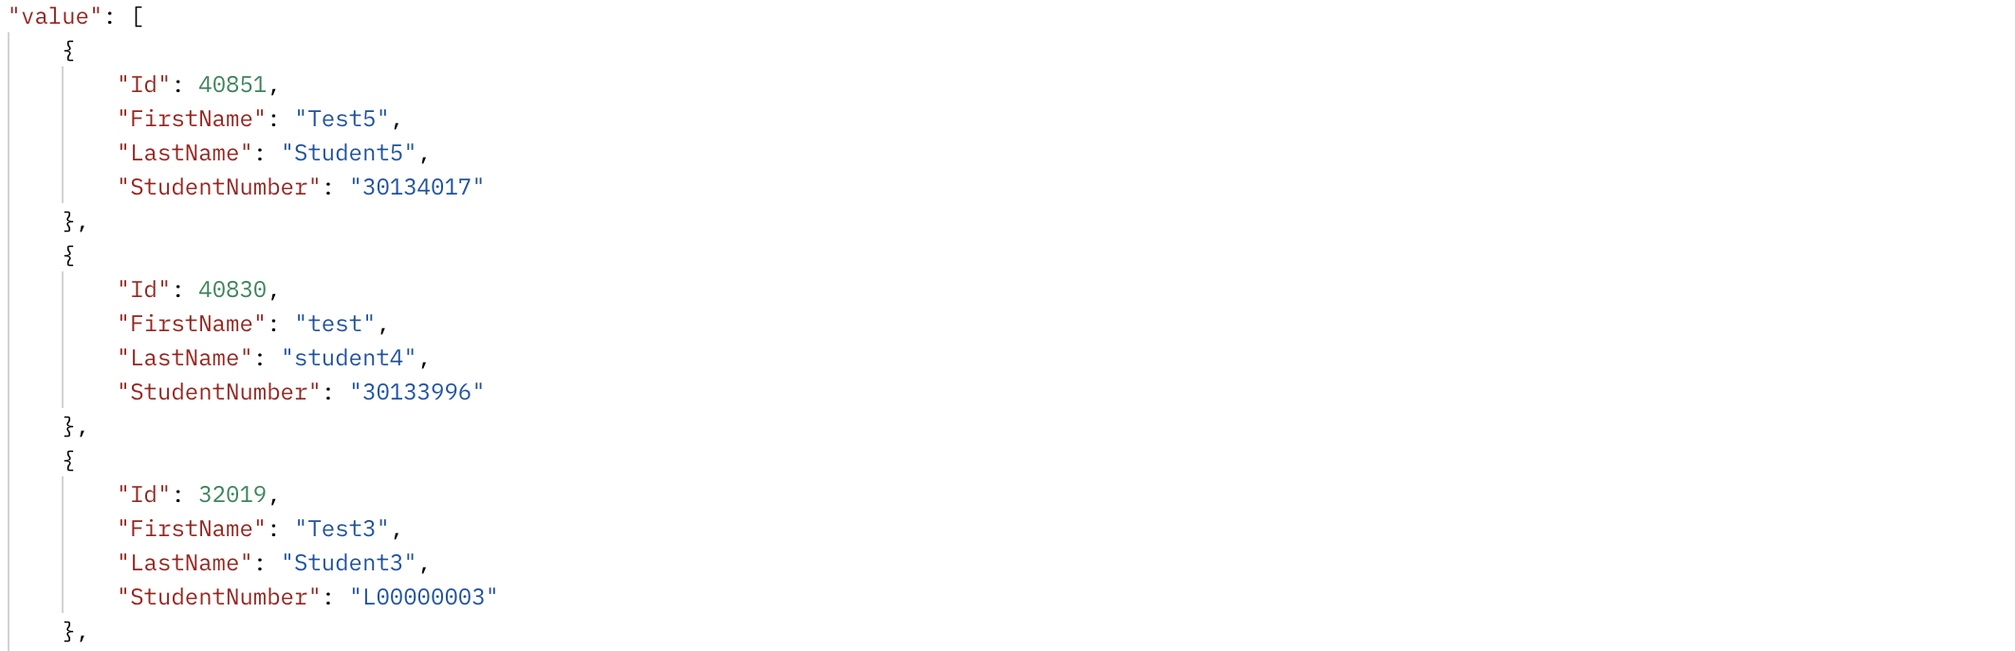
Filtering Results with $filter
.../odata/Students ?$select=Id, FirstName, LastName, StudentNumber &$orderby=LastName desc &$filter=startswith(FirstName, 'Test') and Id ne 36954

Slide 21
Joining Entities with $expand
Get data from multiple linked entities in a single query
Using Navigation Properties
Supports use of other keywords within $expand statements
Nearly infinite ability to nest queries
Limited by URL length, payload size, etc.
The best part of OData!
But also the most dangerous…
$expand calls can exponentially increase the size of a response
By default, all properties of the expanded entities are included
Select only the data that you need!

Slide 22
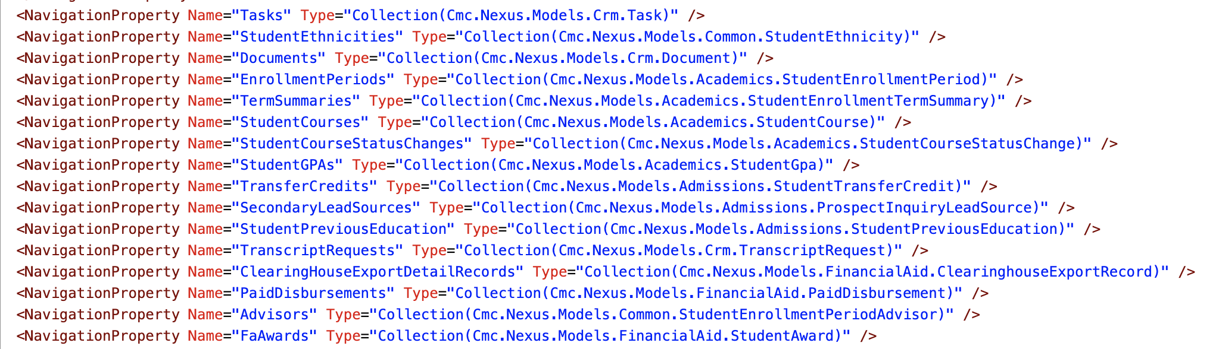
Joining Entities with $expand
Any Navigation Property on an entity can be expanded using $expand

Slide 23
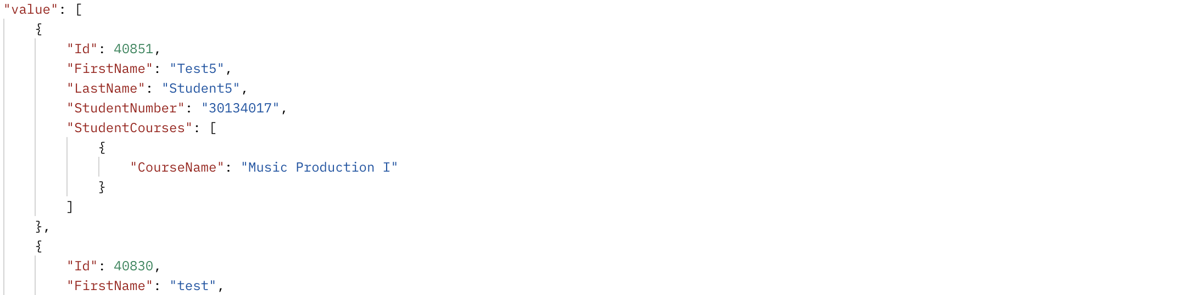
Joining Entities with $expand
.../odata/Students ?$select=Id, FirstName, LastName, StudentNumber &$orderby=LastName desc &$filter=startswith(FirstName, 'Test') and Id ne 36954 &$expand=StudentCourses( $select=CourseName; $filter=Term/Code eq '2022FALLFULLTERM’; $orderby=StartDate desc; $top=1)

Slide 24
OData Strategies
👍
Rules of Thumb

Slide 25
Paging OData Calls
Getting large data sets in sections (pages)
Less taxing on the server
Reduced risk of timeouts
Supported using the $top, $skip, and $count parameters
What is the best page size?
It depends…
Response size
Response time
Query complexity
Don’t overwork the server or network
Keep responses within 3-5 seconds and ~1MB
👍

Slide 26
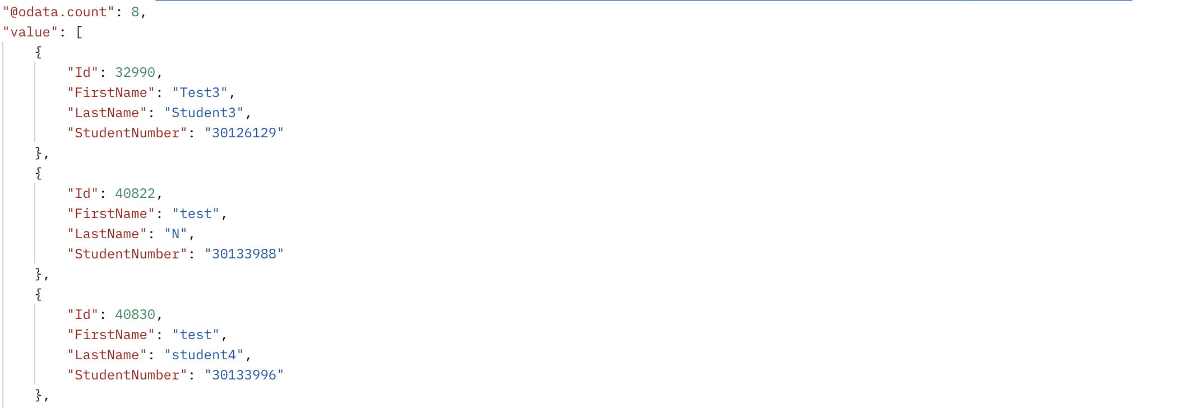
Paging OData Calls
.../odata/Students ?$select=Id, FirstName, LastName, StudentNumber &$top=50 &$skip=3 &$count=true

Slide 27
Chunking OData Calls
I know, it’s not a great word
Breaking up large filters into manageable “chunks” using chained or statements
Similar to paging, but a different approach
Example: Getting student details for a long list of student numbers
$filter=StudentNumber eq 'L00000001' or StudentNumber eq 'L00000002' or ...
Need to contend with URL length limits
No standard rule, but in the ballpark of 2000 characters
Longer values → smaller chunks
👍

Slide 28
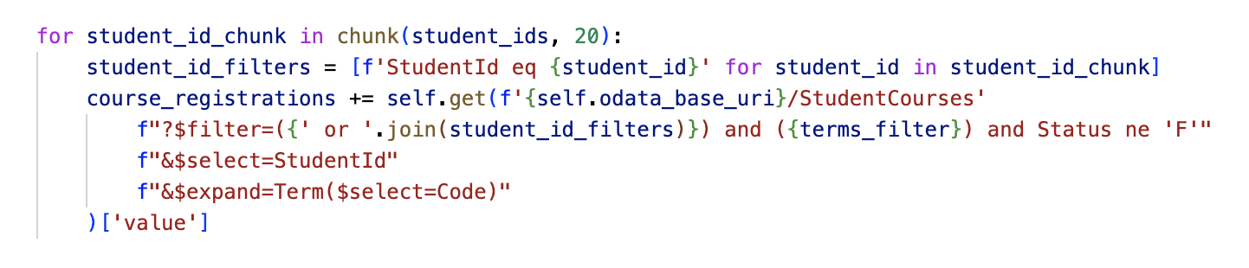
Chunking OData Calls
Real example from LU integrations
Using pydash chunk utility function

Slide 29
Reusing Code
Reusing code is always better, right?
The DRY-er the better?
OData makes that more complicated
Queries should be as specific as possible
Different integrations require different data
Don’t sacrifice performance for a few lines of extra code
Shared utility functions
Paging/Chunking
Date formatting/parsing
Commonly-used filters

Slide 30
Lipscomb’s Integrations Problems

Slide 31
The Issues
Many long-running integrations
Some taking multiple hours
Performance issues with the Student application
Repeated periodic slowdowns
Difficulty reporting using APIs

Slide 32
Identifying the Problems
Partnered with Anthology to perform an analysis of the issues
Reviewed logs of OData calls against the API
Many queries taking multiple seconds or minutes
Some taking upwards of five minutes or more!
A query typically should not take more than a few seconds
Internally reviewed logs of existing integrations
Many were running for 2-4 hours
At one point, an integration was still running into the next morning
👍

Slide 33
What Was Going On?
Not using OData
Not using it correctly and not using it at all
Large, unpaged data sets
Many filtering operations being done in-code
Largely from reporting tools, but also in our integrations
Unused properties being selected
Making many repeated calls on individual records
Get some data first, then get more later for each record
Typically multiple calls for each record within a loop
👍

Slide 34
How Did We Get Here?
Rushed integrations development
Too many integrations to build and migrate, not enough time
Lack of understanding of OData
Incomplete documentation for OData APIs
Outside contractors
Used templates from previous work
Shared data access functions (cached using Redis)
Lack of direct support in reporting tools
Shared application and API server
Initial lack of peer support – much better now
Notes:
Unsure if anyone knew it was the same server for app and API initially
IR Reporting Tools via ODBC connector
Many frequent and long-running “jobs”
No direct paging support
No ability to expand
Improve filtering logic where possible
Need to be able to view logs
“Page” the data using multiple queries based on ID
Use the tools we have

Slide 35
What Did We Do?
Separate integrations server
Consulted with Anthology for improvements
Restructured many integrations
Taking advantage of OData
Restructured queries
Implemented paging
Removed repeated calls and shared data access
Worked with our Institutional Research team to improve queries in reporting tools
Restructured filters
Used expansions where possible
Notes:
Important to have a good working relationship with other departments on campus

Slide 36
What Did We Learn?
How to properly use the tools
Ability to build more complex queries
The integrations are not running in a silo
The effect on other systems must be considered
Policies for efficiently handling large amounts of data
Determine reasonable response sizes and times
When to generalize, and when to be specific
Shared structure and filters, not shared data

Slide 37
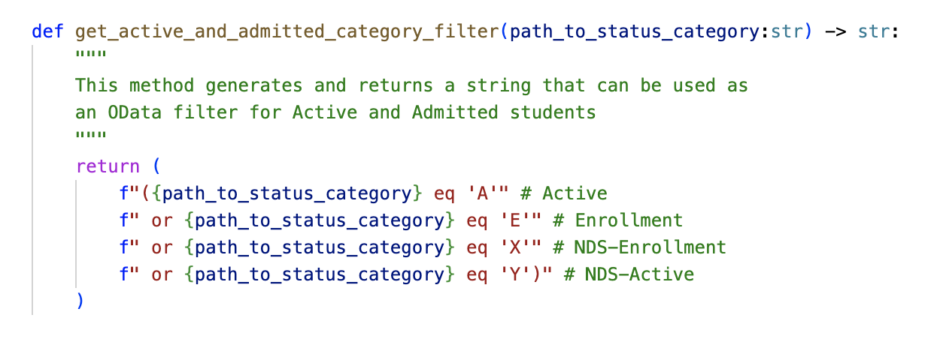
What Did We Learn?
Example of a shared filter function

Slide 38
Where Are We Now?
Most integrations run in < 5-10 minutes
No performance issues for the Student application
Much more comfortable with the tools
Many shared utility functions
Ability to spin up new integrations very quickly
Good internal and external working relationships
Other departments on campus
Anthology integrations team

Slide 39
What Are We Still Improving?
Logging and alerting
Parallelization of API calls
Reduced runtimes
Added complexity and resource consumption
Code reuse
Still a lot of repeated code
Don’t want to over-generalize
Use or build and OData library
Additional improvements in reporting tools
More filters to clean up
Attempt to integration $expand

Slide 40
Takeaways

Slide 41
Tackling Performance Issues
Learn and understand the tools.
The good, the bad, and the ugly
Take a step back.
Survey the landscape
Have good logs.
What, when, and how long?
Beware of the “butterfly effect.”
With great power comes great responsibility
Take responsibility.
Yours, mine, and ours
Notes:
Responsibility: If there’s a runaway train, it doesn’t really matter who caused it. It just needs to be stopped

Slide 42
How can Anthology Help?
New Student deployments have some performance filters in place
e.g. paging required on all requests
Existing deployments are unaffected for now
Logs can be retrieved by request with Support
Example:
GET StudentAccountTransactions/Get
https://[YourInstanceUrl]/ds/odata/StudentAccountTransactions/?$filter=(TermId eq 290)&$select=Id,AcademicYearSequence,AmountPaid,BankAccountId,BillingTransactionCode,CampusId,CreatedByUserId,CreatedDateTime,Description,IsAutomatedProcess,LastModifiedDateTime,LastModifiedUserId,PaidDisbursementId,PaymentPeriodId,PaymentType,PostDate,Reference,Source,Status,StudentAcademicYearPaymentPeriodId,StudentAwardId,StudentId,TermId,TransactionAmount,TransactionDate,TransactionNumber,Type
Durtation: 89290.8936 ms (~2 mins)

Slide 43
Additional Resources
https://docs.anthology.com/
https://developer.anthology.com/
https://www.odata.org/getting-started/
https://github.com/anthology-inc
https://github.com/abgivantlu/at23-lu-odata-examples
Anthology Student Views

